Slide 1
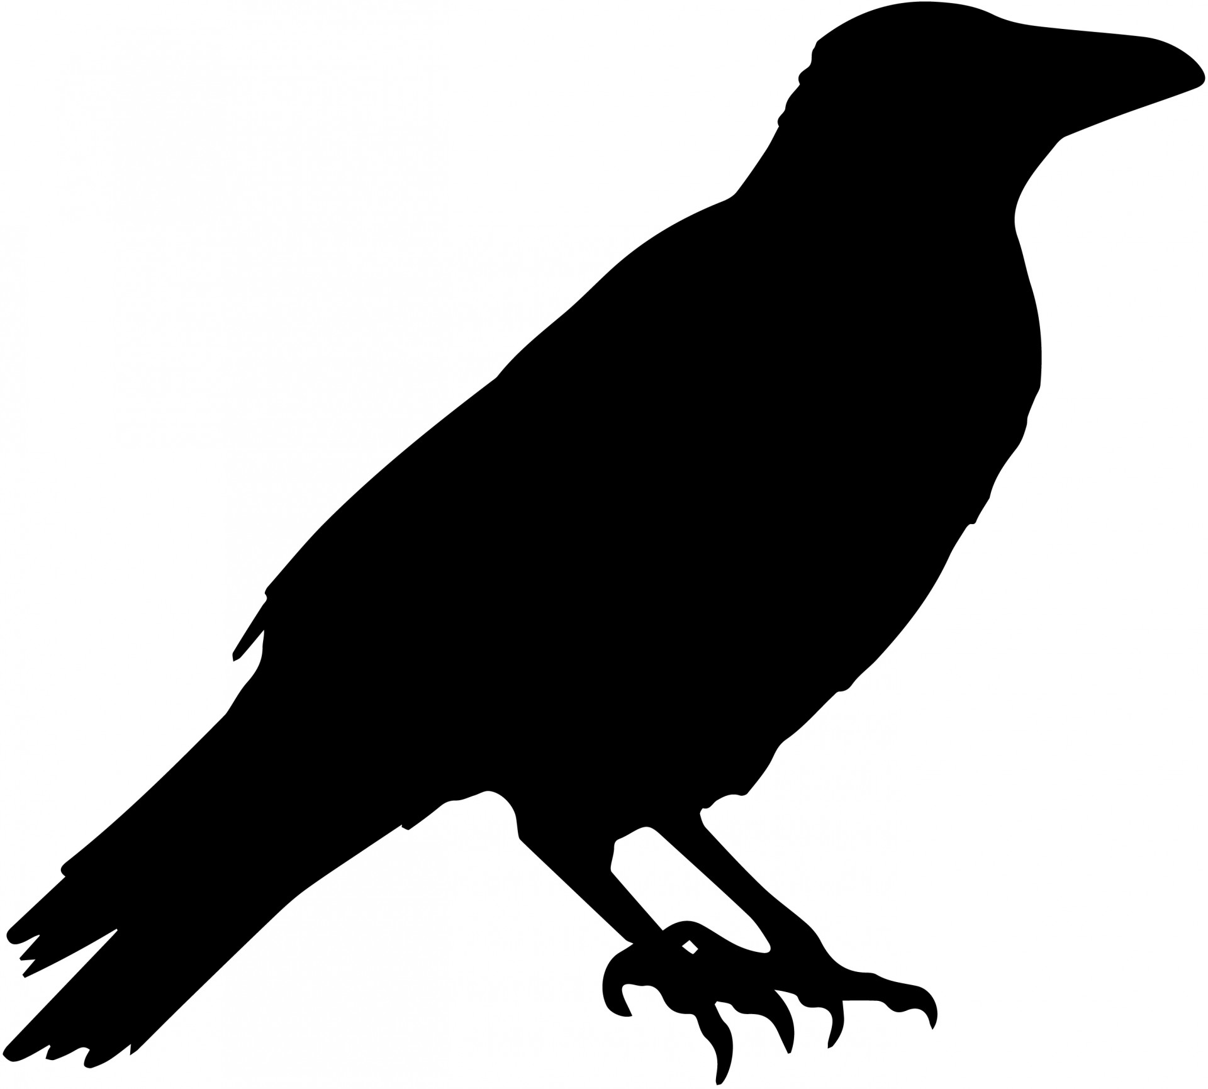
Groundwork Lawrence
Green Team Presents:
2020 Crow Celebration
& Showcase

Slide 2
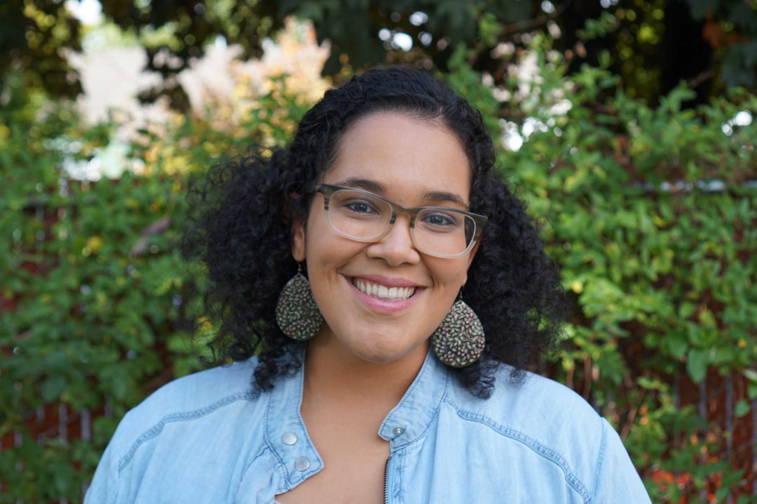
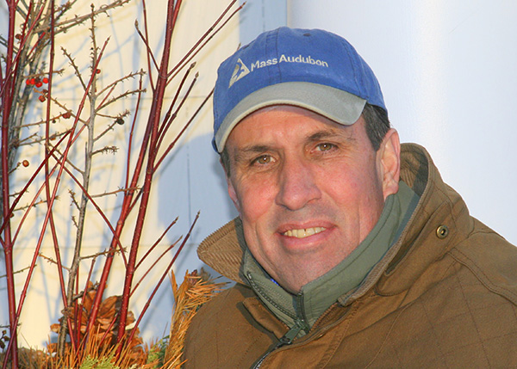
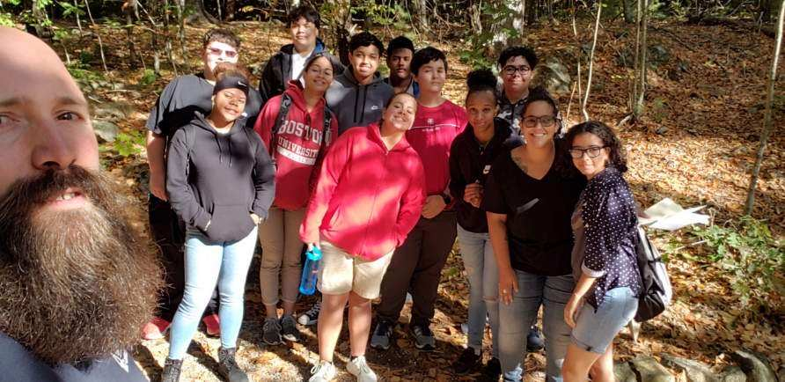
Welcome & Introductions:
Program Coordinator
Yevette Garcia
Green Team
Christian, Griselys, Kristy, Helson, Markos, Jose, Mikayla, Jonathan, Anamaris, Noel
Craig Gibson
Bird & Conservation Photographer, Crow Patrol

Slide 3
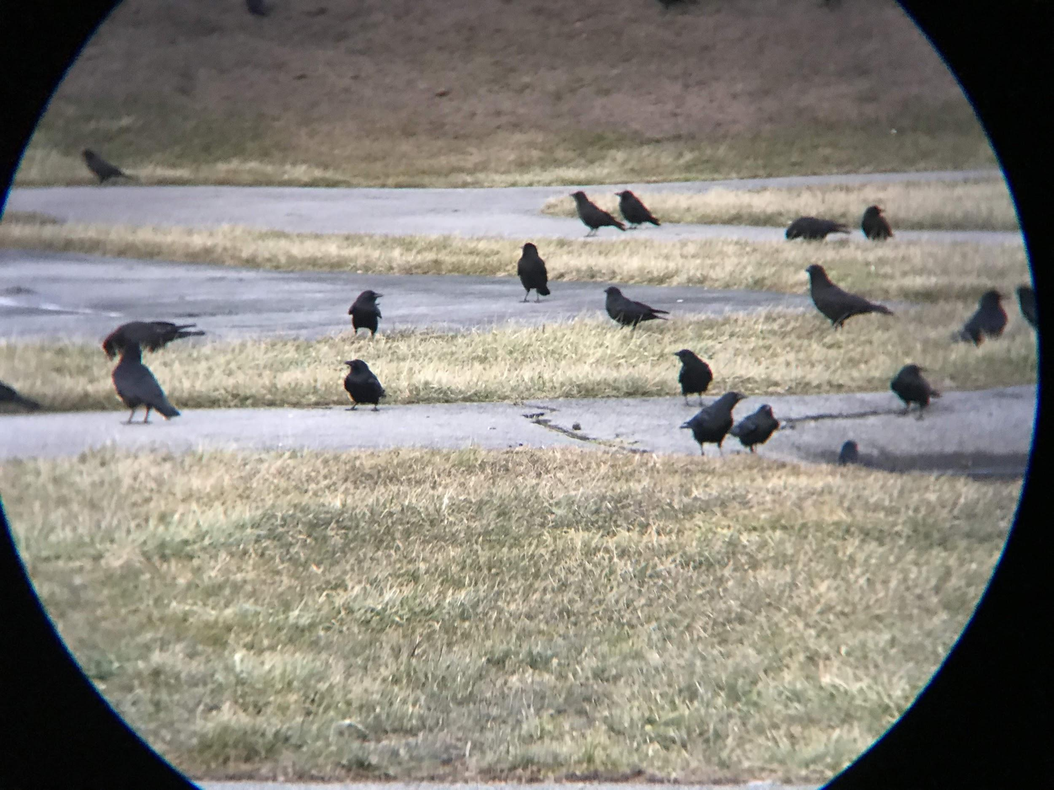
The Cornell Lab of Ornithology: Anything but Common- The Hidden Life of the American Crow
Get to know the Crow:
American Crow aka Corvus brachyrhynchos
American crows - fly over to south canada during breeding season
Families, Flocks, and Creativity:
known as “cooperative breeders”
Foraging flock sizes are larger in the winter months
The Secret life of the American Crow:
Average age of first breeding was 3.3 years for females and 4.9 for males.
American Crow nest success averaged 60%
https://academy.allaboutbirds.org/courses/anything-but-common-the-hidden-life-of-the-american-crow/

Slide 4
American Crow- Life History
Habitat:
- open place
- a few trees to perch in
- a reliable source of food
Food:
nest predator that eats the eggs of sparrows, robins, jays, terns, loons, and eiders.
also eat carrion and garbage
Nesting:
hide their nests in a crotch near the trunk of a tree or branch
both members of a breeding pair help build the nest
clutch Size: 3-9 eggs, number of Broods: 1-2 broods
Behavior:
social birds seen in groups
often stay together in year-round family groups
work together and devise solutions to problems to drive off predators
Conservation:
global breeding population at 27 million
88% spending part of the year in the U.S., and 37% in Canada
susceptible to West Nile virus
https://www.allaboutbirds.org/guide/American_Crow/lifehistory#habitat

Slide 5
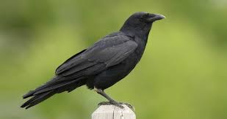
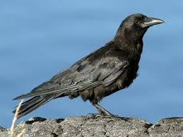
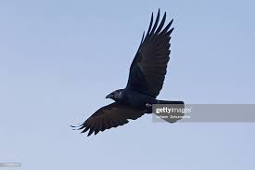
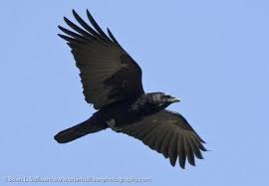
Fish VS American Crow: What’s the difference?
Fish Crow
American Crow
Heavy, curved bills
Longer, thinner wings
Square tails that are longer than that of the American crow
Nasal sounding “cow” notes
Slight gloss to the plumage
Long bill
Shorter wings, but thicker wingtips
Slightly bigger
Full-throated calling call “caw”

Slide 6
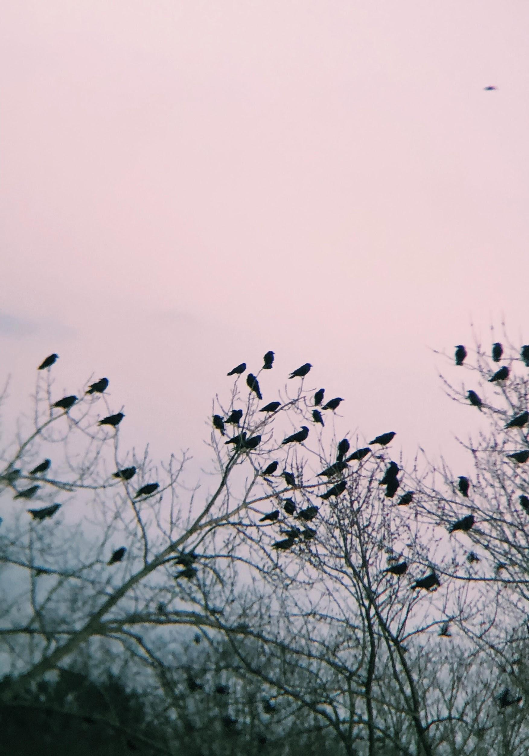
Crow Observations & Notes
Around 2,000-10,000 crows observed per day.
Crows arrived at different sites until it was time for staging
Incinerator Rd. Sanitation Center in North Andover. Railroad St- North Andover
In our presence they were alert
Made “Caw Caw” sounds
Change in population number and roosting/staging time
We tried different tactics every night to make observations
Notes:
Hi, I’m Kristy, and I would be sharing with you a bit about our observations from what we have experienced while bird watching:
Our estimated number of crows per every crow watching day we had was around 2,000-10,000. The highest being during the peaks of winter.
Everyday thousands of crows arrived in big clusters every evening settling near the riverbank, until it was time for their daily performance
Usually in our presence they were alert.
Depending on the night the crows were louder than usual and made sounds like “caw caw”
As winter was coming to an end the numbers started to drop off and as the days were getting longer, their roosting started later on.
Crows flew out and over in clusters, often times viewing their roosting location and then returning to tops of trees, vocalizing to the greater murder of crows, in their return.
To make better observations we decided to look closer at crow pairs rather than them as a whole to see their behavior during these small scale interactions (found crows nestled one on top of another).
And now I’II ask Christian to lead us into the next topic

Slide 7
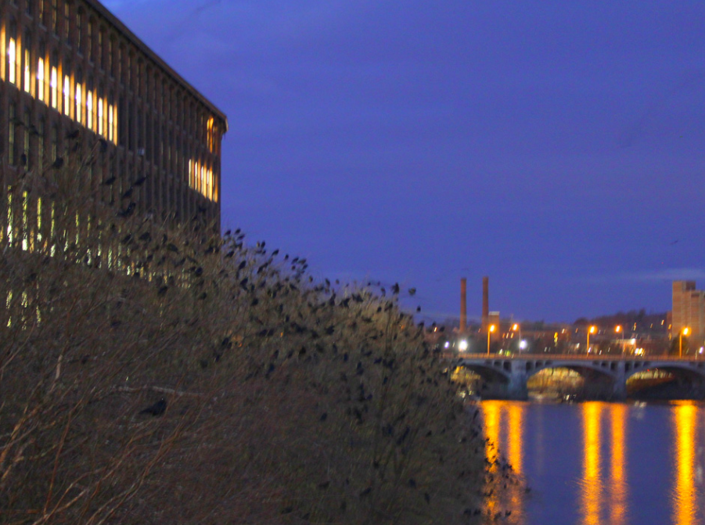
Research Findings: Our discoveries & theories
Lawrence: urban area- Food & Waste Present- Cities like Lawrence provide protection from predators.
Crows roost near sources of water and on high trees- things largely present along the Merrimack River.
Crows roost in large numbers between 5:00-6:30 PM.
Roosts occur later as it gets colder, the closer crows roost, the warmer they will be. Also acts a way of protection from predation.
Photo Credit: Craig Gibson
www.wintercrowroost.com

Slide 8
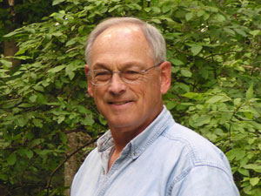
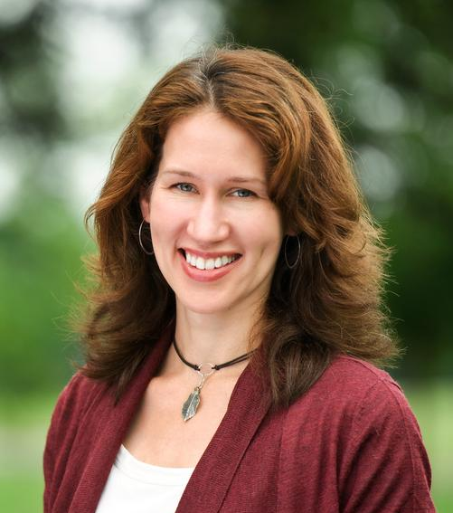
Virtual Speaker Series: Ornithologists share their wisdom.
Wayne Peterson: Director of Mass Audubon’s Important Bird Areas (IBA) program.
Andrea Townsend: Assistant Professor of Biology at Hamilton College.

Slide 9
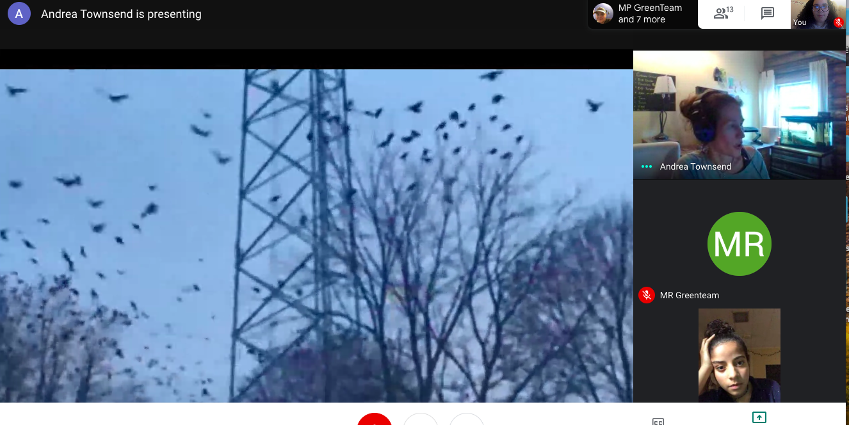

Slide 10
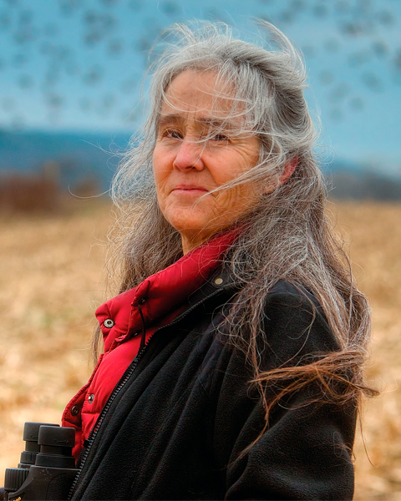
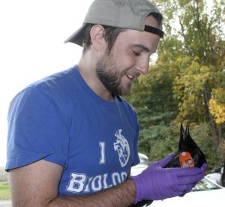
Virtual Speaker Series: Ornithologists share their wisdom.
Anne B. Clark: Associate Professor of Biological Sciences at Binghamton University.
Connor O’Loomis: Ph.D Candidate & assistant professor at Binghamton University.

Slide 11
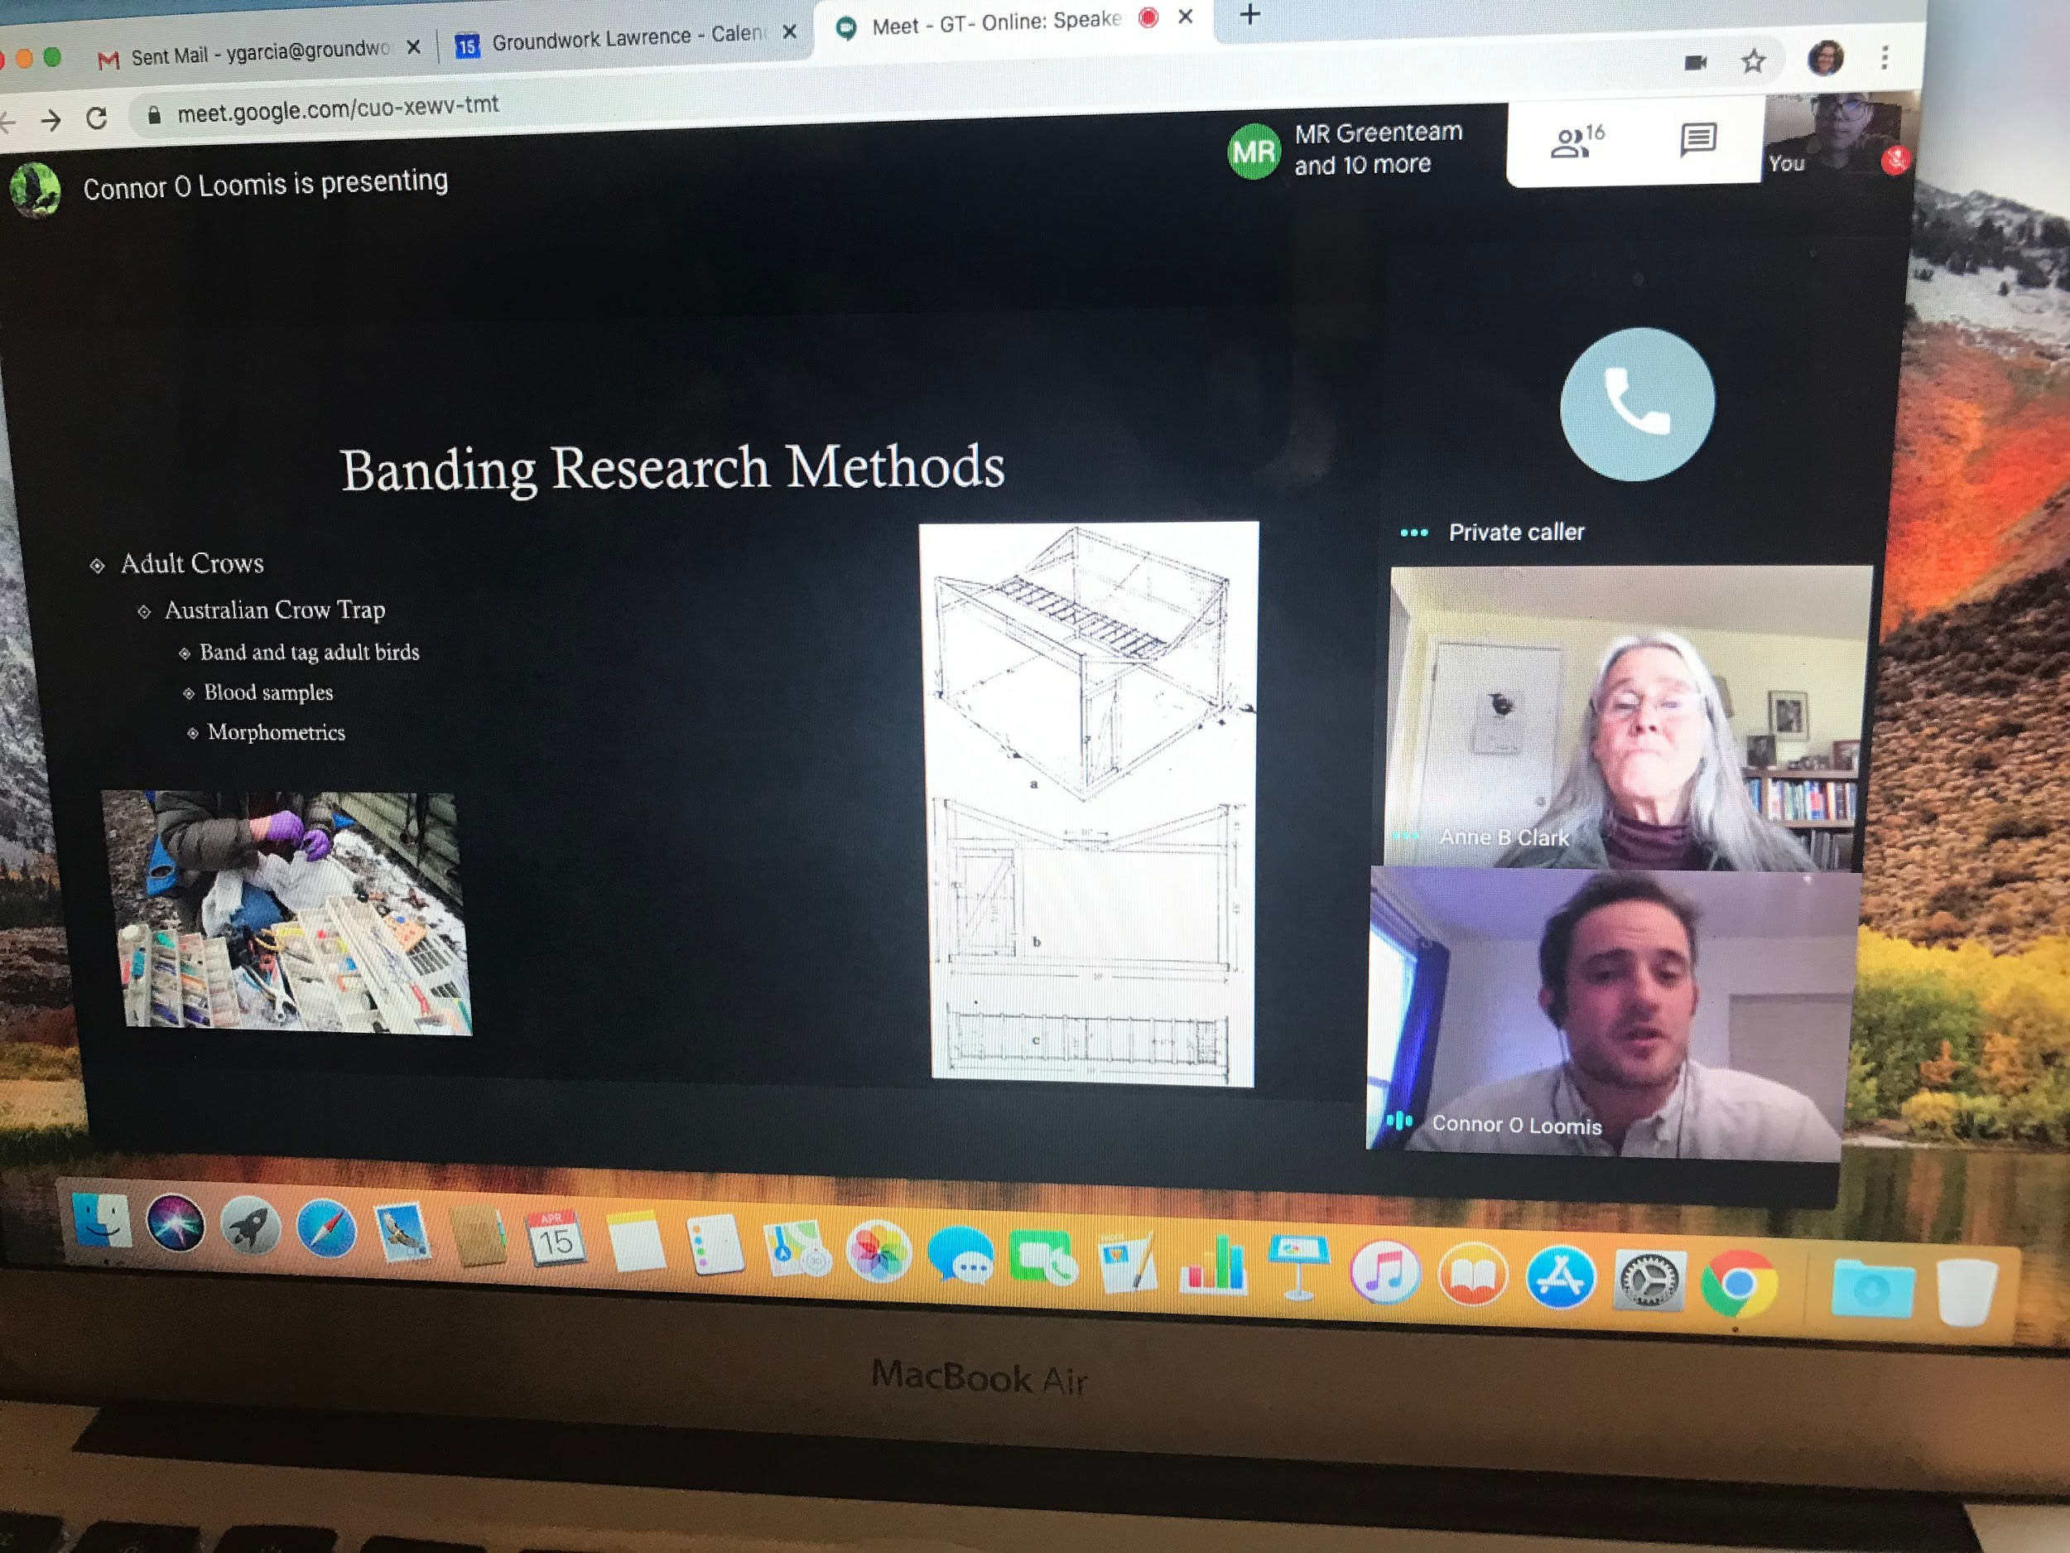

Slide 12
American Crows: Family & Community bonds
Basic social unit for American Crow is the family.
American Crows Practice “allopreening” .
Younger crows stay with their parents for up to five years or even longer.
Young crows help their parents raise the young. They help feed the incubating female and nestlings.
Defend the territory/stand guard over other family members while they hunt for food.
Resident family groups spend at least part of every day on their home territories, but spend time with the big flocks and roosts, too.
Include extended family members such as nephews, brothers, and half-brothers of the mom and dad.
Crows “adopt” the kids of unrelated neighbors.
https://academy.allaboutbirds.org/topic/home-and-family-life/

Slide 13
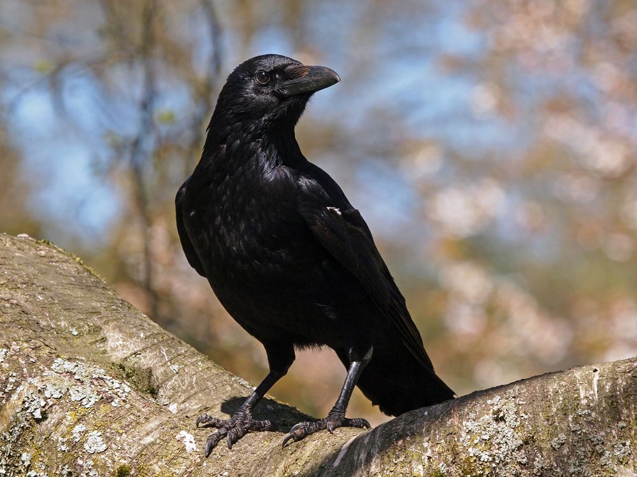
American Crows: Fun Facts
Crows have this uncanny ability to tell one human from another.
Crows are crafty foragers...
Gather in large numbers in the winter to sleep in shared roosts.
Roosts can be from a few hundred up to 2 million crows.
The oldest recorded wild American Crow: 16 years 4 months old.
Oldest Captive Crow in New York: 59 years old.
Crows sometimes make and use tools.
https://www.allaboutbirds.org/guide/American_Crow/overview#_ga=2.144738676.1125739568.1587566261-1022295770.1587566261

Slide 14
Caw VS Croak- Inside the calls of
Crows & Ravens

Slide 15
Who Am I: Interactive Activity

Slide 16
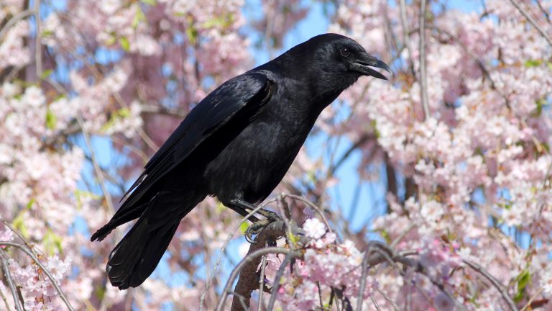
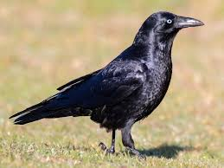
Crow Vs Raven
Although Crows and raven look fairly similar, There are a few key features of the bird that can help you distinguish which bird is which.
The picture on the left is a American Crow.

Slide 17
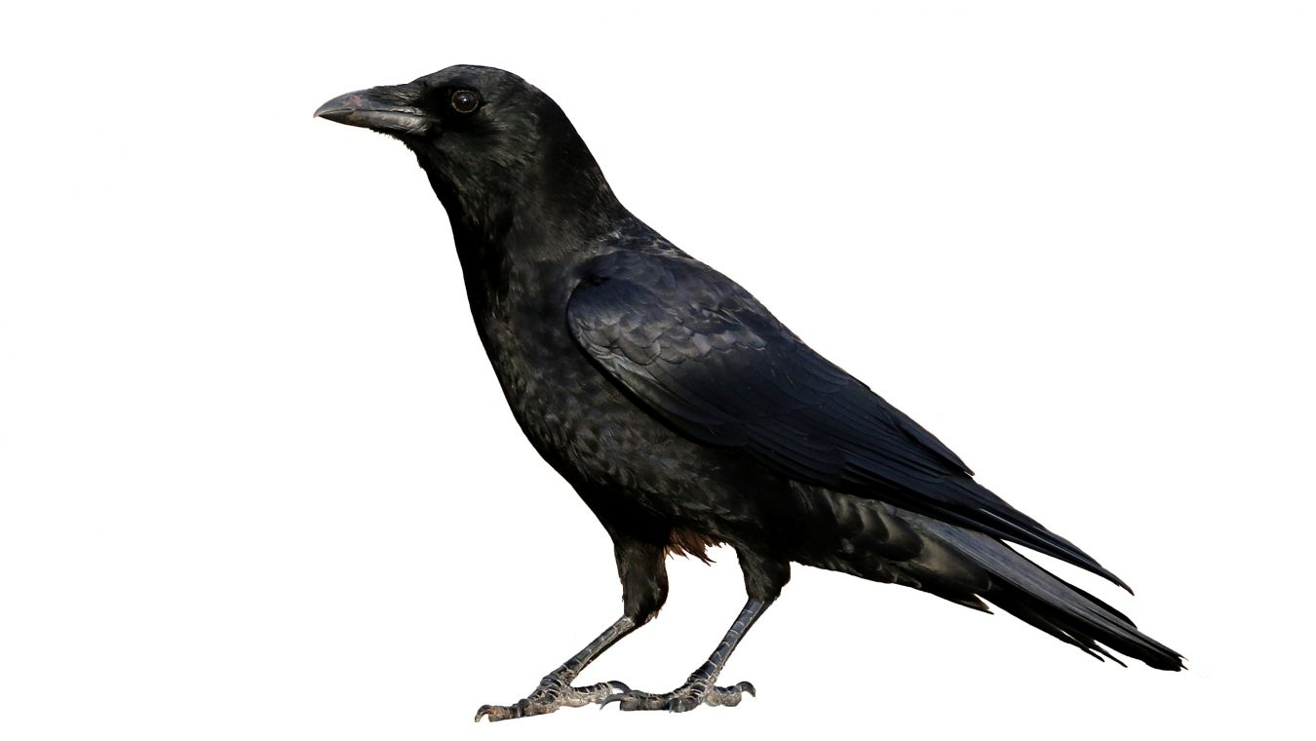
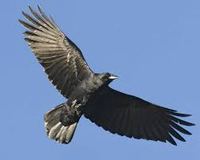
Crow Vs Raven
This is a American Crow. They are all black with a moderate bill. Their tails are rounded off while in flight.

Slide 18
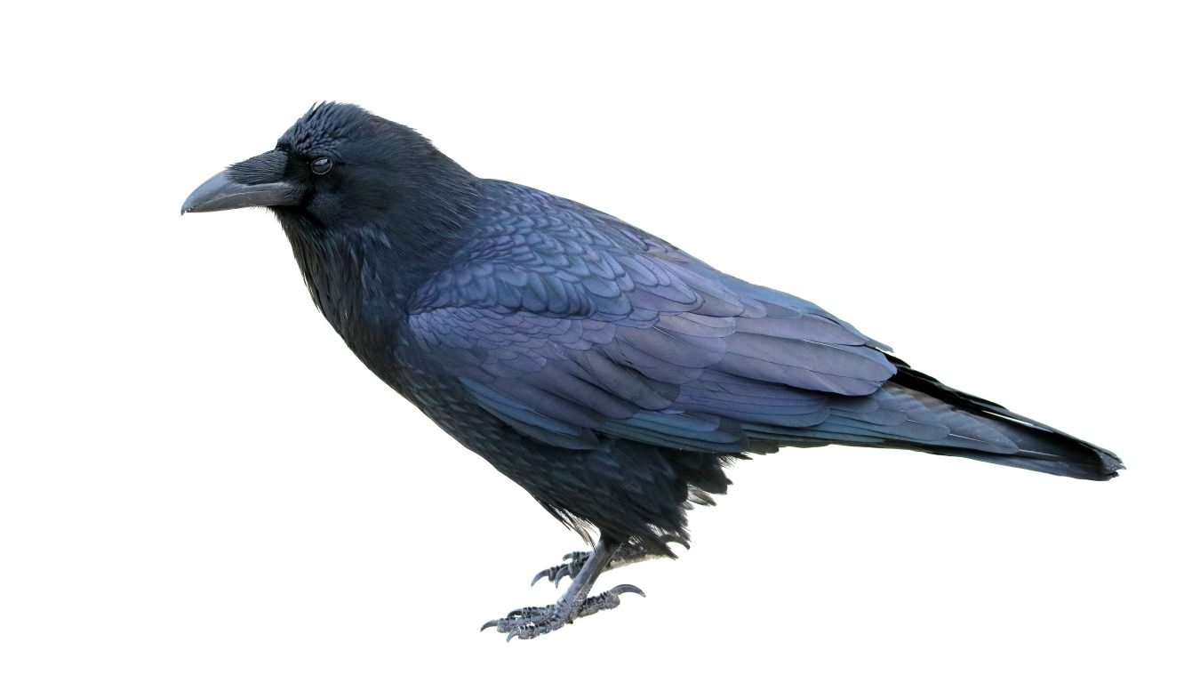
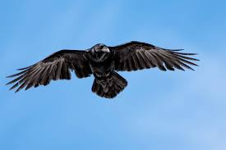
Crow Vs Raven
This is a Raven. They are all black with a blue-ish tint and have a long stout bill. Their tails are diamond shape while in flight. They have very pronounced nasal feathers and saggy throats.

Slide 19
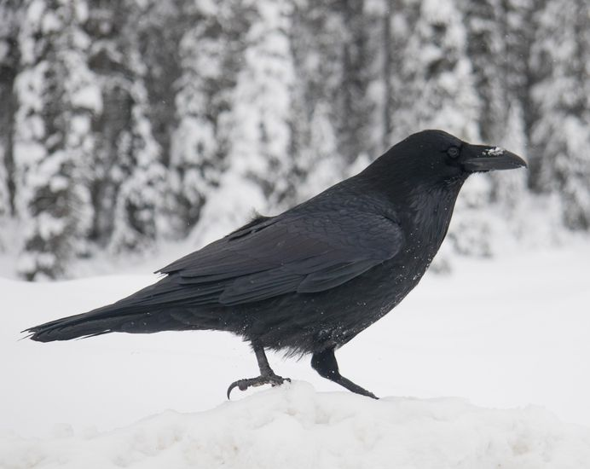
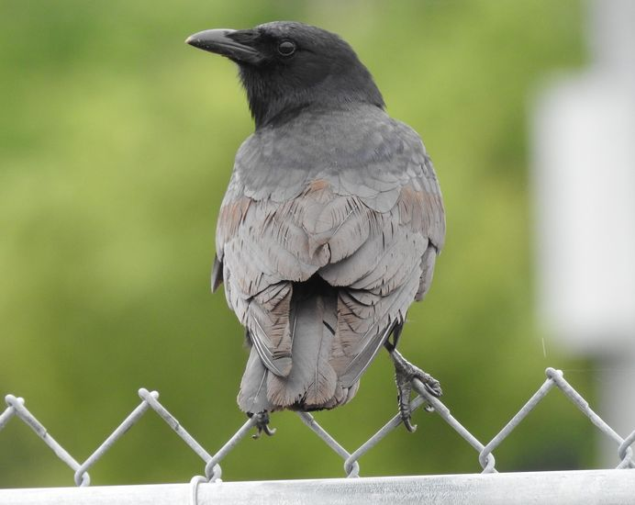
Crow Vs Raven
Which one is the American Crow?
The American crow is the one on the right. Notice how the Raven on the left has bigger, pointed beak.

Slide 20
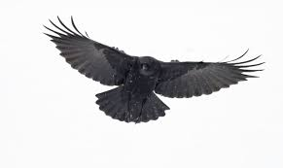
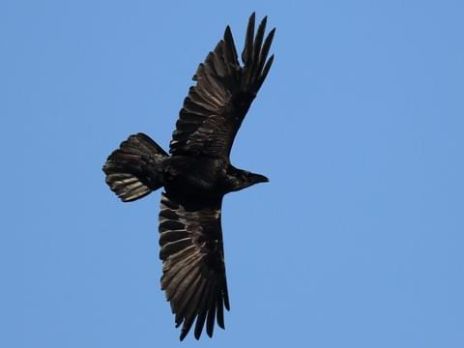
Crow Vs Raven
Which one is the American Crow?
The American crow is on the left. Notice the rounded off tail feathers on the crow.

Slide 21
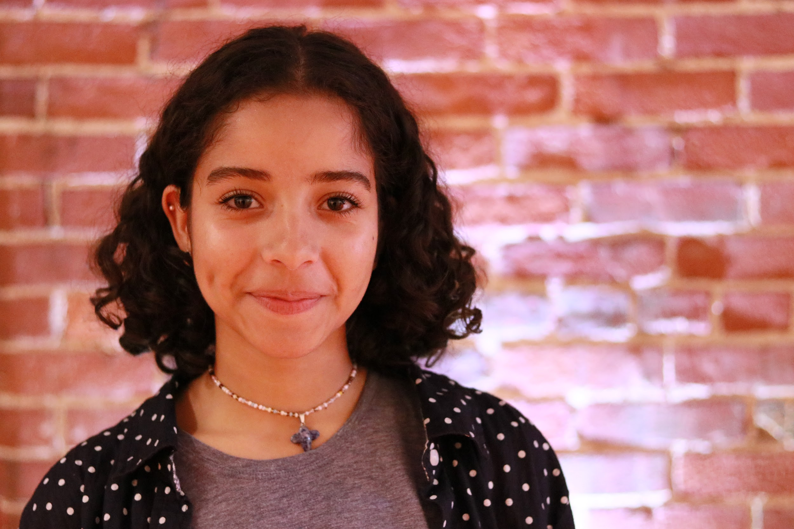
Spoken Word: Kristy Martes
Wary Crows --- poem by Kristy
Oh, weary bird, you of dark feathers and glary eyes,
so under-appreciated, these maverick people,
who in you, flaws always find;
Your bizarre nightly ritual,
rowing through the skies of dark blue and gleaming stars,
conquering the space with your vicious black;
Your riveted eyes, watchful for jewels and shine,
to give your most cherished lover an offering of enshrine;
Yours calls alert the flock, as strange figures arise.
You embark in your flight,
Not because of fear, but pride.
Your brilliance is unvalued, You remain wary,
born for survival.
You subside to show your competence,
Your magnificence is not for everyone to regard.
You who are called down,
seemed as less than,
treated unfairly,
seen as a dark sinful figure,
You... you still look up and in congruence you force fight.
Notes:
Wary Crows --- poem by Kristy ( DO NOT EDIT)
Oh, weary bird, you of dark feathers and glary eyes,
so under-appreciated, these maverick people,
who in you, flaws always find;
Your bizarre nightly ritual,
rowing through the skies of dark blue and gleaming stars,
conquering the space with your vicious black;
Your riveted eyes, watchful for jewels and shine,
to give your most cherished lover an offering of enshrine;
Yours calls alert the flock, as strange figures arise.
You embark in your flight,
Not because of fear, but pride.
Your brilliance is unvalued, You remain wary,
born for survival.
You subside to show your competence,
Your magnificence is not for everyone to regard.
You who are called down,
seemed as less than,
treated unfairly,
seen as a dark sinful figure,
You... you still look up and in congruence you force fight.

Slide 22
Now for our feature Crowsentation!

Slide 23
Crow-Sources: Stay Connected!
https://www.massaudubon.org/
https://www.birds.cornell.edu/home/
https://academy.allaboutbirds.org
https://ebird.org/home
http://www.wintercrowroost.com/

Slide 24
Thank you for Joining us!

